Slide 1
DEPARTMENT OF CSE/ CSIT/ AI&DS
COURSE NAME –CLOUD DEVOPS
Engineering
COURSE CODE – 22SDCI05A
GITHUB

Slide 2
AIM OF THE SESSION
To familiarize students with the basic concept of Specialized Process Models
INSTRUCTIONAL OBJECTIVES
This Session is designed to:
Understand repositories, commits, branches, and merges.
Install Git, configure settings, and initialize repositories.
Track, commit, and view changes effectively.
Work with remote repositories using pull, push, and merge.
Maintain clean history and resolve conflicts efficiently.
LEARNING OUTCOMES
At the end of this session, you should be able to:
Describe various specialized process models
Summarize phases of unified process

Slide 3
What is Git?
Git is a distributed version control system that tracks changes in code, facilitates collaboration, and manages project history efficiently.
Before Git, centralized version control systems (CVCS) like Subversion (SVN), CVS, and Perforce were widely used. These systems relied on a central server to store the complete project history, with developers working on local copies. While they allowed collaboration, they had limitations such as a single point of failure, slower operations, and difficulty managing parallel development. Git revolutionized version control by introducing a distributed model, enabling each developer to have a full repository copy and improving performance, flexibility, and reliability.

Slide 4
Hosting repositories on Github facilitates the sharing of codebases among teams by providing a GUI to easily fork or clone repos to a local machine.
By pushing your repositories to Github, you will pretty much automatically create your own developer portfolio as well

Slide 5
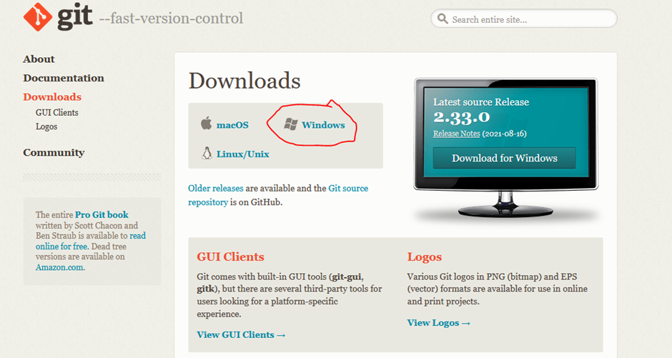
Deploy Files to Github via GIT
Install gitbash software
https://git-scm.com/downloads

Slide 6
Configuring git
# Set your name
git config --global user.name "Your Name"
# Set your email
git config --global user.email "bindugarikapati7@gmail.com"
# Verify the configuration
git config --global --list

Slide 7
configure Git with the email ID bindugarikapati7@gmail.com:
$ git config --global user.name "Bindu Garikapati"
$ git config --global user.email "bindugarikapati7@gmail.com"
$ git config --global --list
user.name=Bindu Garikapati
user.email=bindugarikapati7@gmail.com

Slide 8
Initialize a Git Repository:
$ git initInitialized empty Git repository in /path/to/your/directory/.git/
Create Text Files:
$ echo "Hello, this is my first file." > file1.txt
$ echo "This is my second file." > file2.txt

Slide 9
Check the Status: $ git status
On branch main
No commits yet
Untracked files:
(use "git add <file>..." to include in what will be committed)
file1.txt
file2.txt
nothing added to commit but untracked files present (use "git add" to track)

Slide 10
Stage the Files:
$ git add file1.txt file2.txt
Check the Status Again:
$ git status
On branch main
No commits yet
Changes to be committed:
(use "git rm --cached <file>..." to unstage)
new file: file1.txt
new file: file2.txt

Slide 11
Commit the Changes:
$ git commit -m "Initial commit with two text files"
[main (root-commit) abc1234] Initial commit with two text files
2 files changed, 2 insertions(+)
create mode 100644 file1.txt
create mode 100644 file2.txt

Slide 12
Replace /path/to/your/directory with your working directory path.
View the Commit History:
$ git log --oneline
abc1234 (HEAD -> main) Initial commit with two text files
Note:
Replace /path/to/your/directory with your working directory path.

Slide 13
Generate the SSH Key:
ssh-keygen -t ed25519 -C bindugarikapati7@gmail.com
(OR)
ssh-keygen -t rsa -b 4096 -C "bindugarikapati7@gmail.com"
Save the Key Pair:
When prompted:
Press Enter to save the key to the default location (~/.ssh/id_ed25519 or ~/.ssh/id_rsa).
Enter a passphrase for additional security (optional).

Slide 14
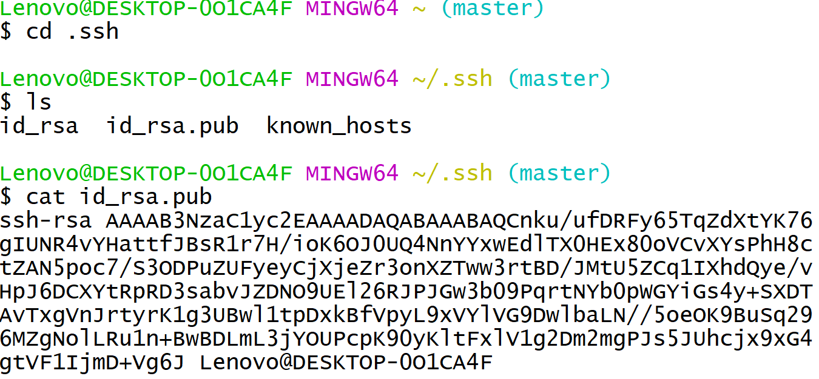
To check the public key is configured or not
Key creation

Slide 15

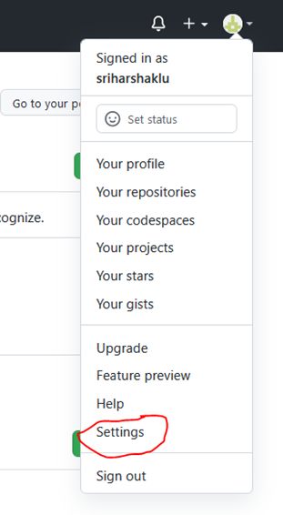

Slide 16
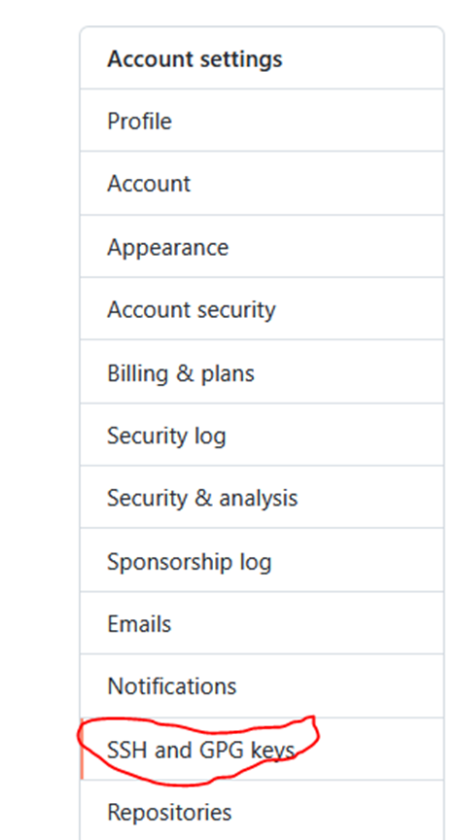
Click on settings

Slide 17
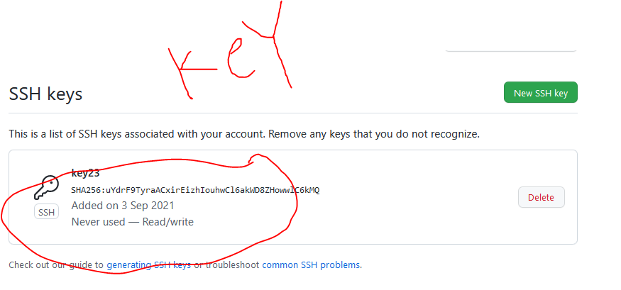

Slide 18
Step : if key not there follow steps
Follow the steps to generate RSA Key
Public key generation
So we need to generate key
Steps to generate key

Slide 19
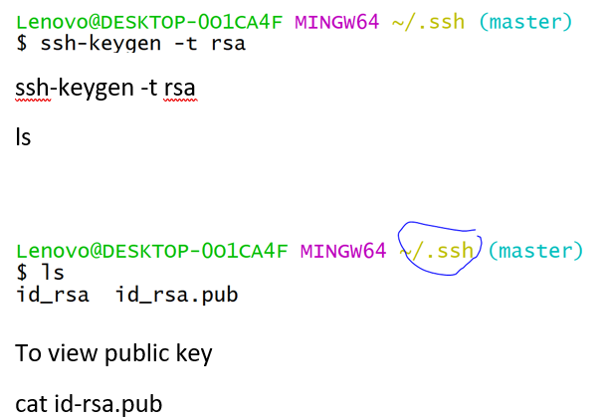
Cd .ssh

Slide 20
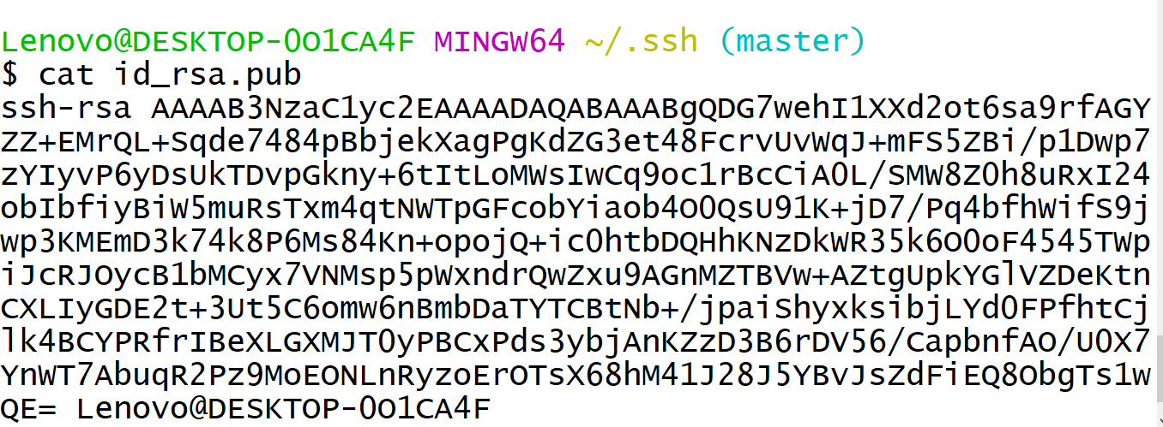
Copy code with no blank spaces

Slide 21
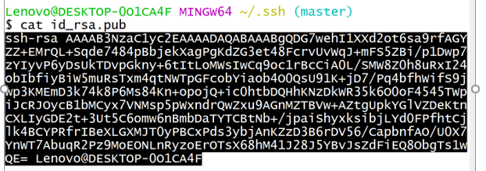

Slide 22
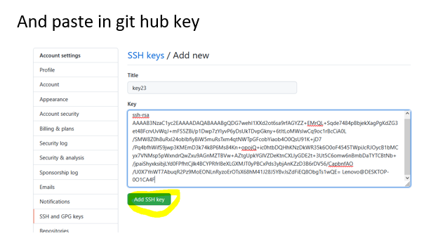

Slide 23
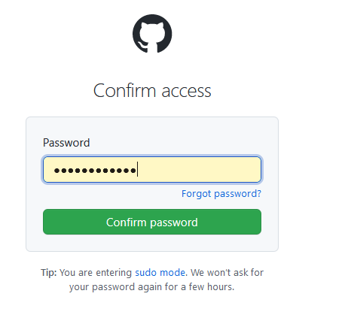

Slide 24
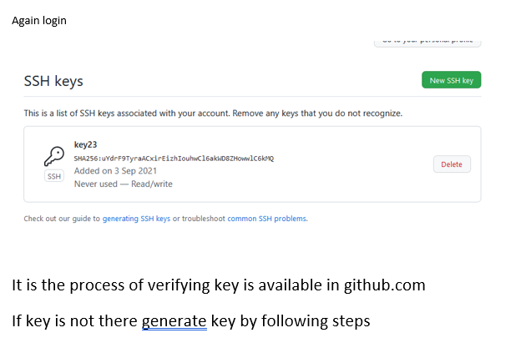

Slide 25
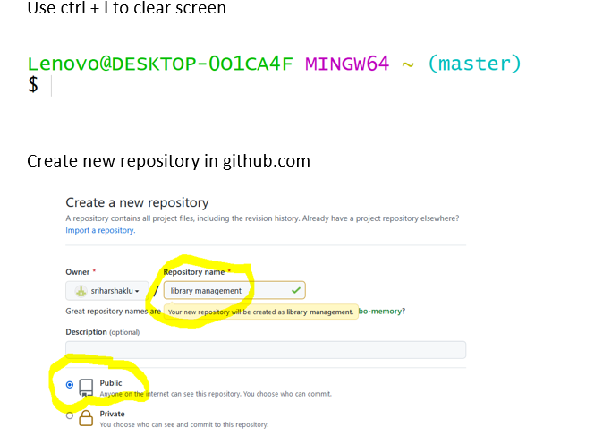

Slide 26
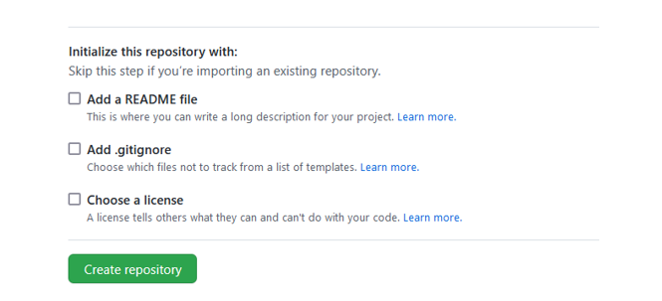

Slide 27
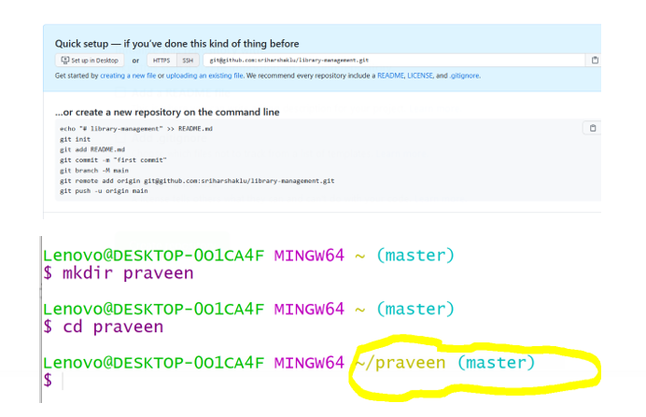

Slide 28
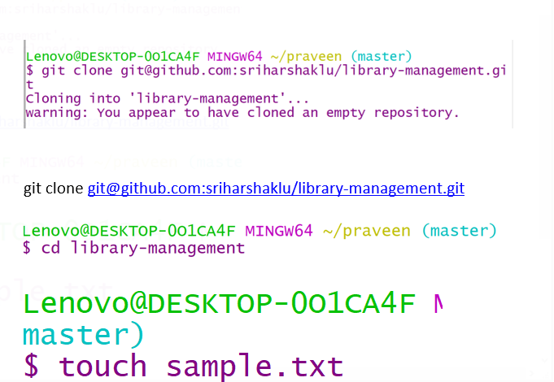

Slide 29
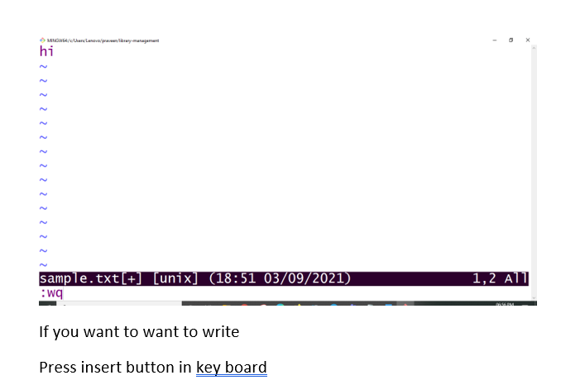

Slide 30
If you want to want to write
Press insert button in key board
After writing the code
If you want to close vi prompt
Press esc button
Then type
:wq
Press enter
To come to main prompt i.e $

Slide 31
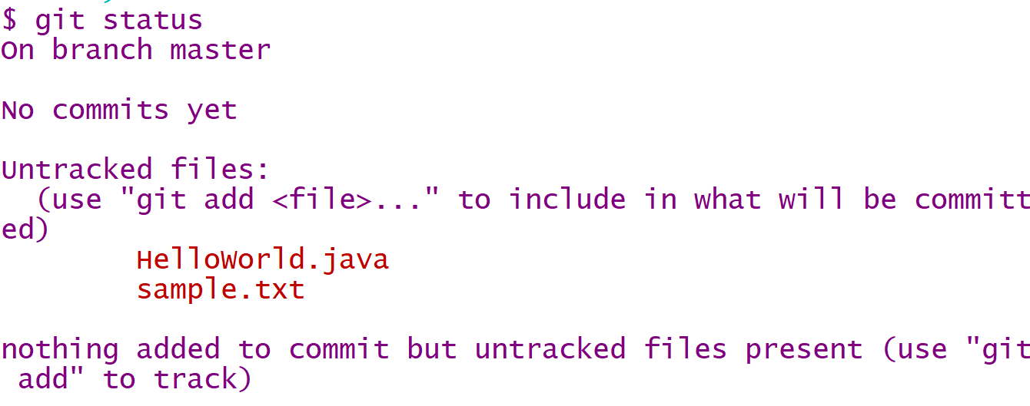

Slide 32
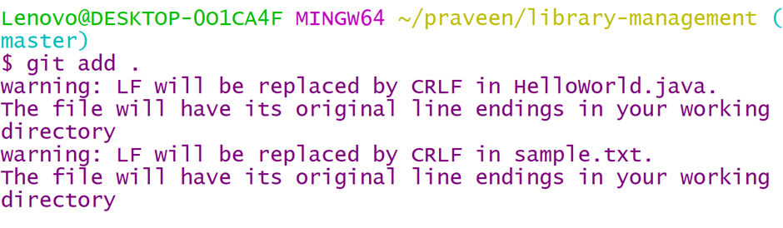
The apply command
git add .

Slide 33
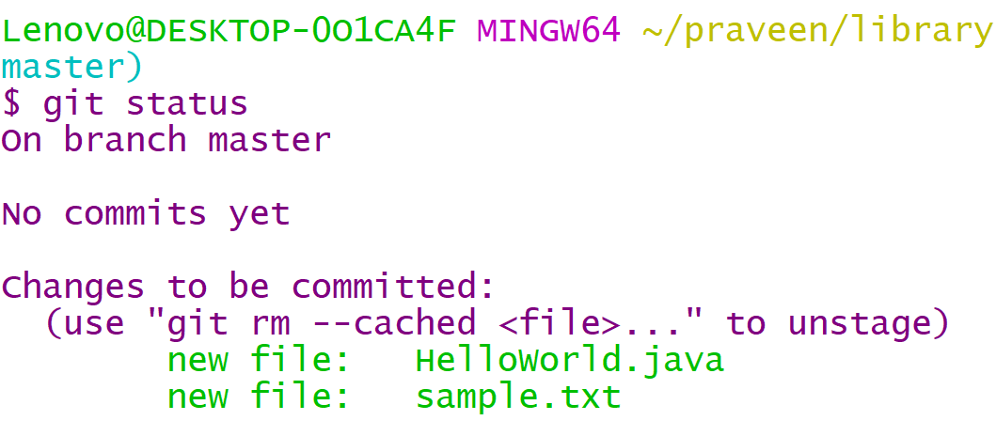

Slide 34
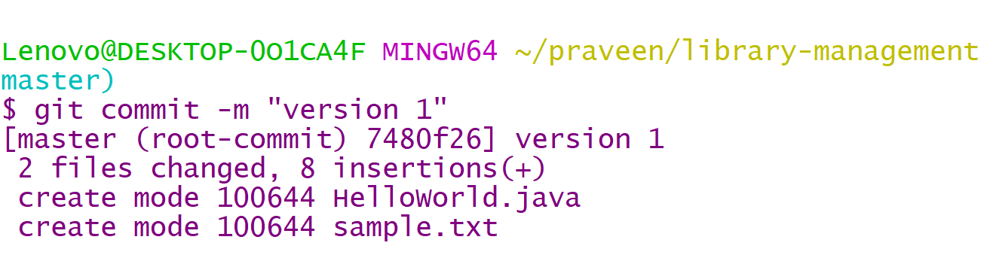
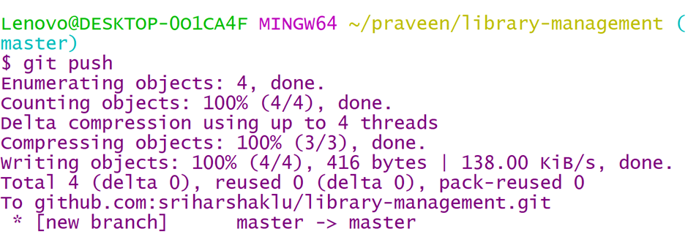
files are green color indicates that added to github repository

Slide 35
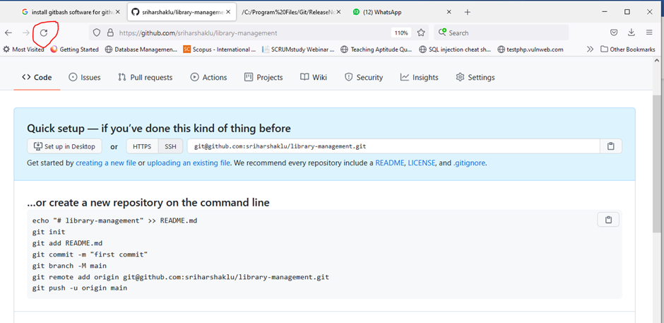
Refresh the github repository page

Slide 36
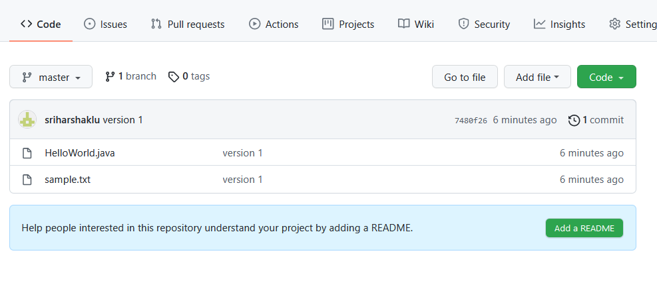

Slide 37
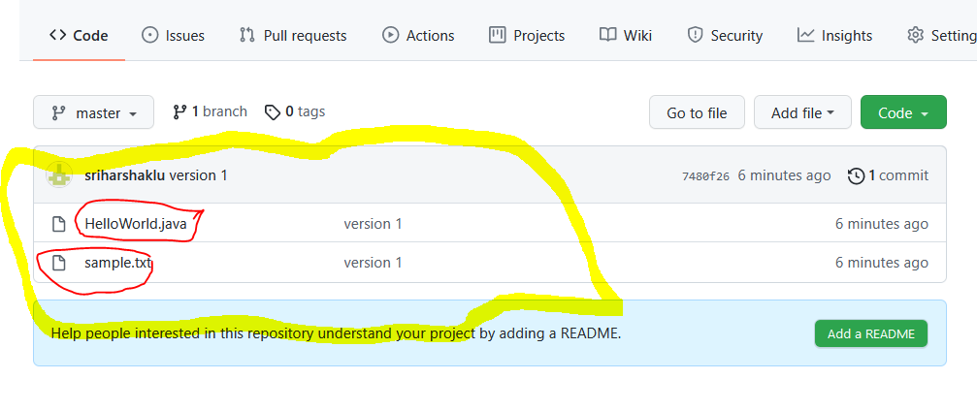

Slide 38
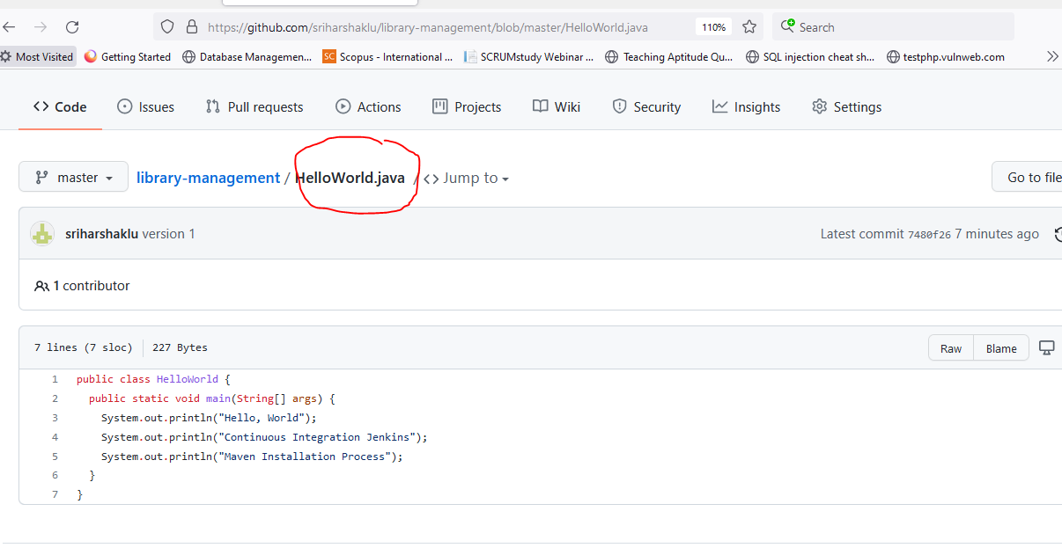
Click on HelloWorld.java

Slide 39
Then create pipeline in azure to build java program

Slide 40
Connecting git with Github
In order to prevent having to enter your password each time you push up to Github, you must configure git and Github to recognize Secured Shell (SSH) keys that you generate.
To check and see if you have any recognized SSH keys active on Github, go to https://github.com/settings/keys
If you do not see any SSH keys listed, you do not have SSH configured with Github. We can assist with this later.
If using Mac OS X, you can also configure your keychain to automatically enter your password via HTTPS.

Slide 41
Connecting git with Github
From your project directory, run `git init` to initialize a git repository.
Go to Github and create a new repository with the name of your project.
Follow the instructions on Github to connect your initialized git repository to the remote server on Github.
Please Note: you must have files in your project directory to commit in order to push anything to your remote server.

Slide 42

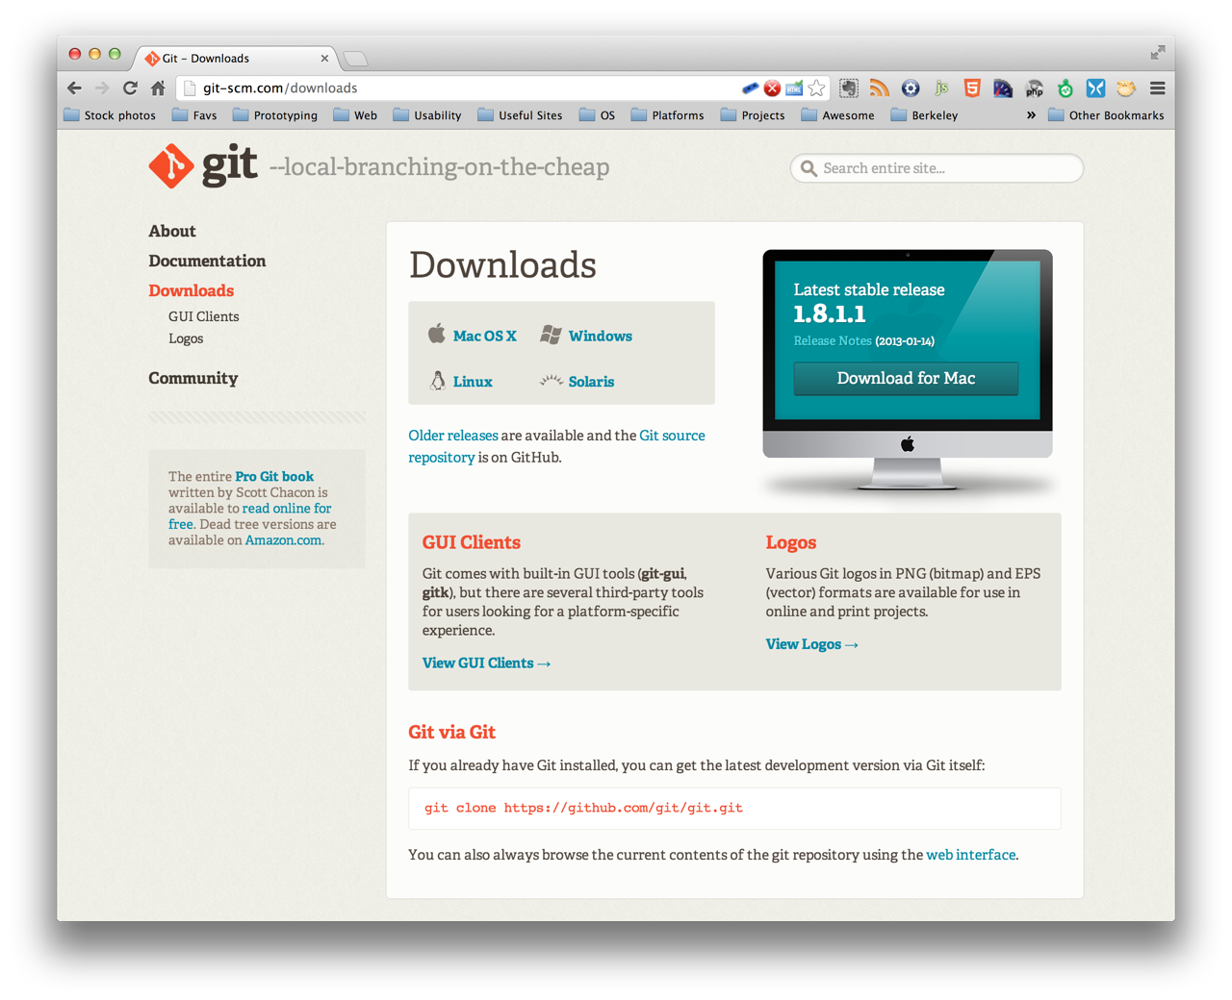
installing git
http://git-scm.com/downloads
Notes:
We’ll be using the git command line interface, but feel free to choose your preferred solution GUIs, Editor Extension etc

Slide 43
Basic git / Github workflow
From your project repo on Github, navigate to the Issues tab and create a new Issue
From the command line, use git to create a new branch off of master to make your edits to. To tie the branch to your issue on Github, make sure to include the issue number after the branch name, e.g. branchName #1
Stage edits to be committed to your git repository by using `git add ` to track the files that you want to add directly or `git add .` to add all files at the current directory level that you have worked on.
Commit changes using `git commit -m ` and be sure to leave a short but descriptive message detailing what the commit will change when merged to the master branch.
Push changes to save them by using `git push origin

Slide 44
Basic git / Github workflow
On Github, create a new pull request for the branch that you have just pushed, and add any clarifying comments that you deem necessary.
In order to close the issue associated with the pull request, tell GitHub to do so by adding ‘closes ’ in the comments. (you can also use ‘closed, fix, fixes, resolve, resolves, and resolved’ before the issue number as well).
Github will automatically check for merge conflicts. If there are any, check to see what they are and resolve them.
• Once everything is up to date, Github will allow you to merge using three separate options: Merge; Squash and Merge; Rebase and Merge

Slide 45
git branching
git branch to view current branches in repo
git checkout -b to create a new branch with branch name
git checkout without ‘-b’ flag to switch to existing branches

Slide 46
Merging vs Rebasing
From a conceptual standpoint, git merge and git rebase are used to achieve the same ultimate goal: to integrate changes from one branch into another branch.
There are, however, distinct mechanics to both methods.

Slide 47
git merge: pros
Generally the easiest option to merge your master branch into your current working feature branch.
You can `git checkout feature` and then `git merge master` or you could just do it with one command: git merge feature master
By doing this, you create a new ‘merge commit’ in your feature branch, which is a non-destructive operation that ties the histories of both branches.
This preserves the exact history of your project

Slide 48
git merge: cons
The branch that you merge will always have an extraneous merge commit that will be tracked every time you need to incorporate upstream states.
• In other words, it essentially creates a forked history at the point where you merge.
• This can lead to muddling the history of your branch, thereby making it more difficult for yourself or other developers to track the history of changes using `git log` and/or roll back to previous states.

Slide 49
git rebase: pros
To rebase, you would `git checkout feature` and then `git rebase master`.

Slide 50
git rebase: pros
To rebase, you would `git checkout feature` and then `git rebase master`.
• Instead of creating a merge commit, rebase will move the entire feature branch to start from the tip of the master branch by rewriting the project history and creating brand new commits for each commit in the original branch.

Slide 51
git rebase: cons
Because rebase rewrites project history, you lose the context provided by a merge commit, i.e. you won’t be able to see when upstream changes were actually integrated into the feature branch.
More importantly, you could potentially cause extreme difficulty by rebasing master to the tip of your feature branch, leading git to think that your master branch’s history has diverged from the rest

Slide 52
Merge conflicts
Merge conflicts arise when two members of the same development team work on the same file and try to merge in their respective changes.
The proper way to avoid merge conflicts would be to ensure that only one branch is fully committed, pushed, and merged to master, allowing the other branch to integrate any changes before attempting to push and merge to master.
If merge conflicts arise, don’t fret! Many text editors (as well as Github) provide tools to help track down conflicts and resolve them. Often times, it will show incoming changes juxtaposed with the current state of your file, and allow you to choose which to keep (one or both)

Slide 53
SELF-ASSESSMENT QUESTIONS
Describe about work flow of github.
2. List the Various commands in github.
Difference between branching and merging in github
Importance of installing and deploying a file in github via gitbash.
Infer about pros and cons on git rebase in project management.

Slide 54
REFERENCES FOR FURTHER LEARNING OF THE SESSION
TEXTBOOKS:
1. Roger S.Pressman, “Software Engineering – A Practitioner’s Approach” 7th Edition, Mc Graw Hill,(2014).
2. Ian Sommerville, “Software Engineering”, Tenth Edition, Pearson Education, (2015).
3. Agile Software Development Ecosystems, Jim Highsmith, Addison Wesley; ISBN: 0201760436; 1st edition
Reference Book
Agile Modelling: Effective Practices for Extreme Programming and the Unified Process Scott Amber John Wiley & Sons; ISBN: 0471202827; 1st edition.
WEB REFERNCES/MOOCS:
https://www.digite.com/kanban/what-is-kanban/
http://www.scaledagileframework.com
https://www.guru99.com/test-driven-development.html
https://junit.org/junit5/

Slide 55

THANK YOU
Team – ADAPTIVE SOFTWARE ENGINEERING

